Slide 1
Practice Exam
AWS Certified Solutions Architect – Associate Exam

Slide 2
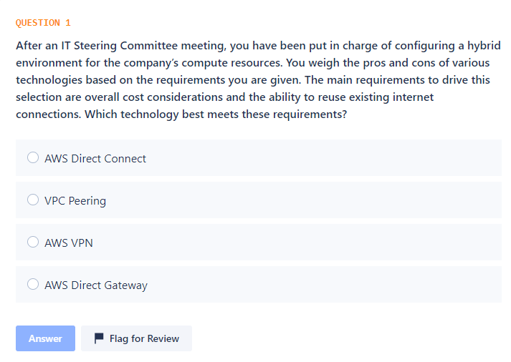

Slide 3
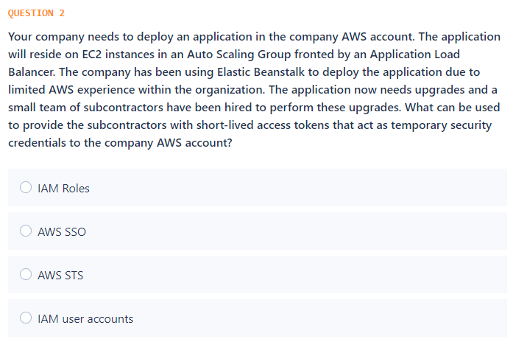

Slide 4
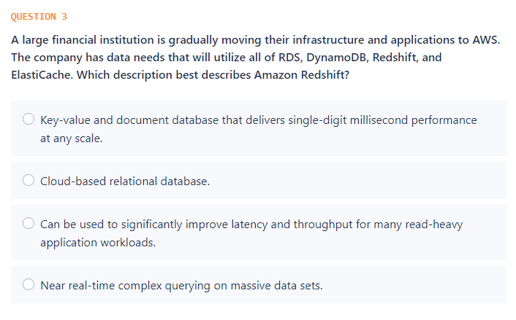

Slide 5
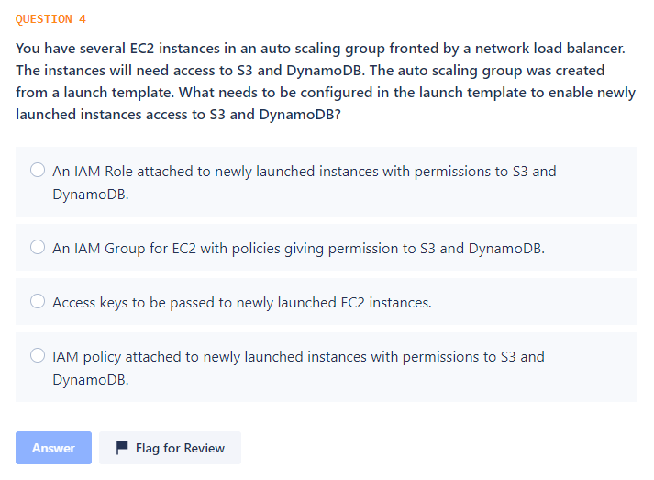

Slide 6
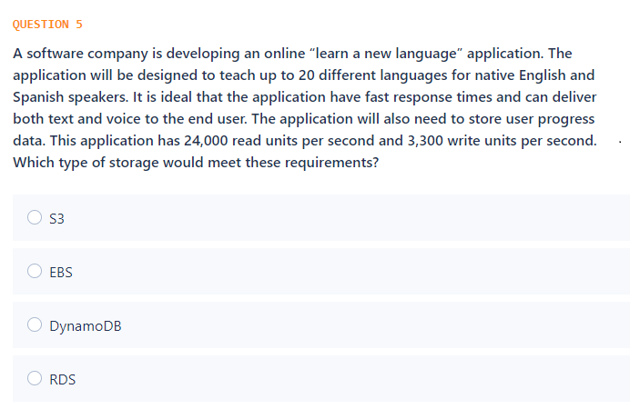

Slide 7
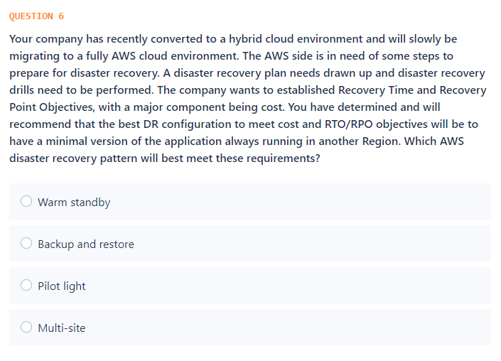

Slide 8
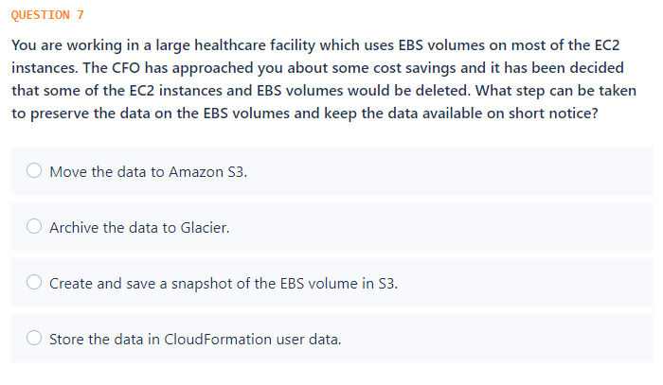

Slide 9
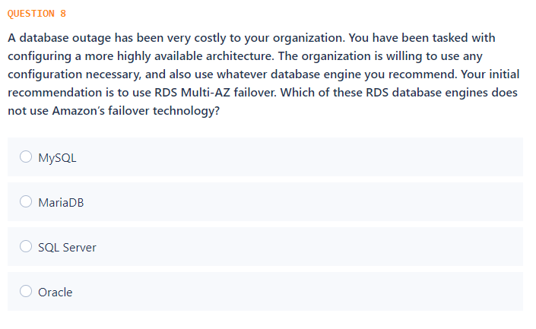

Slide 10
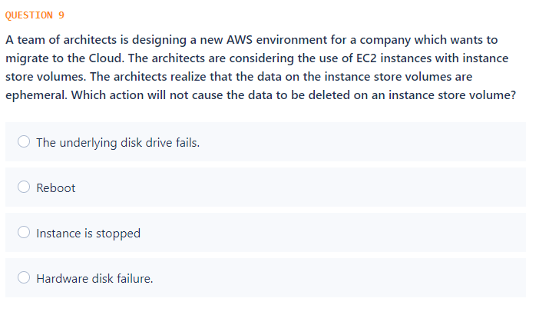

Slide 11
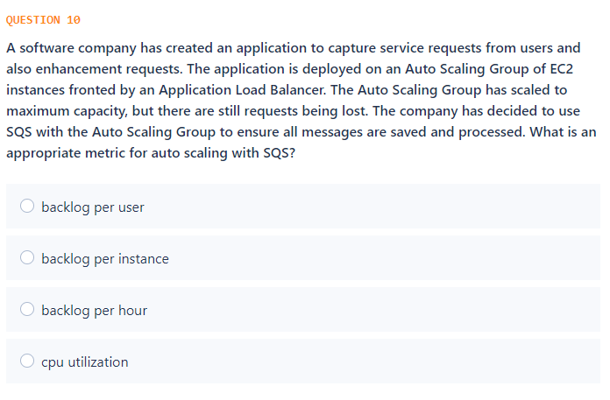

Slide 12
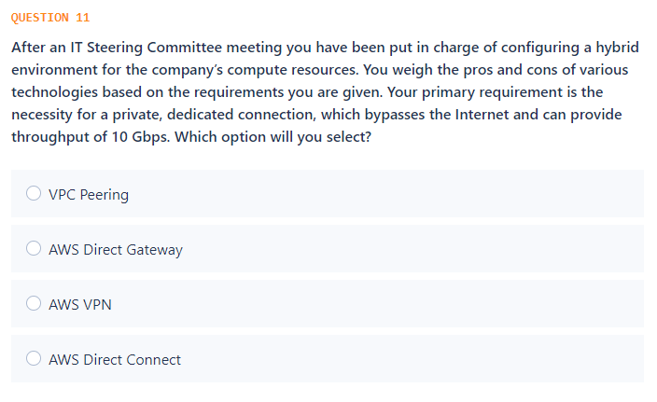

Slide 13
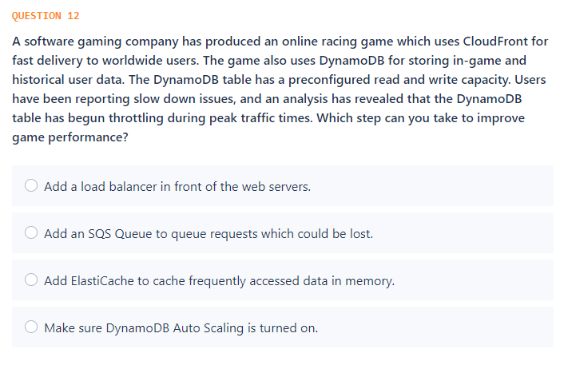

Slide 14
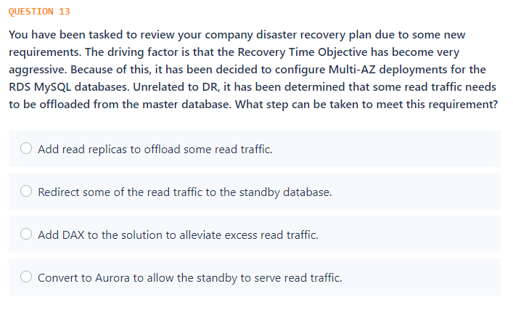

Slide 15
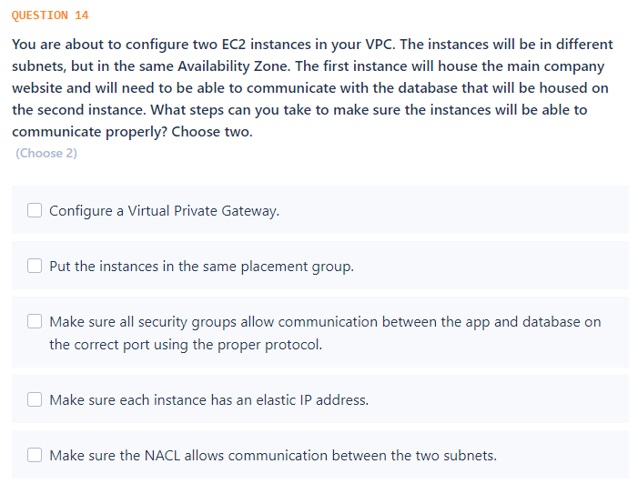

Slide 16
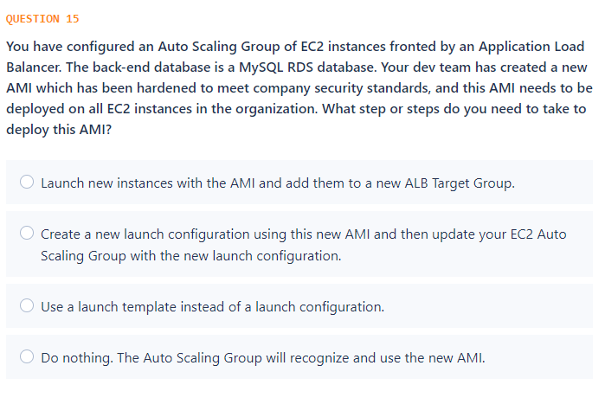

Slide 17
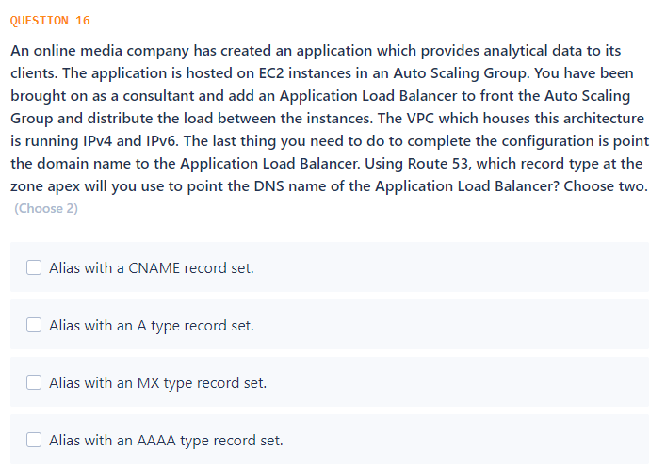

Slide 18
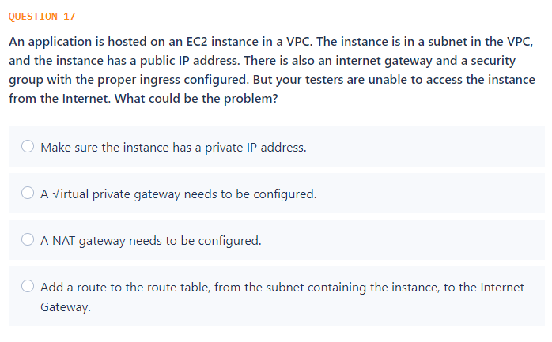

Slide 19
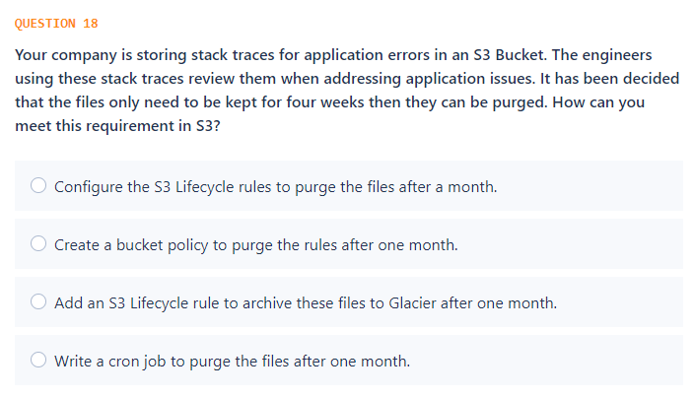

Slide 20
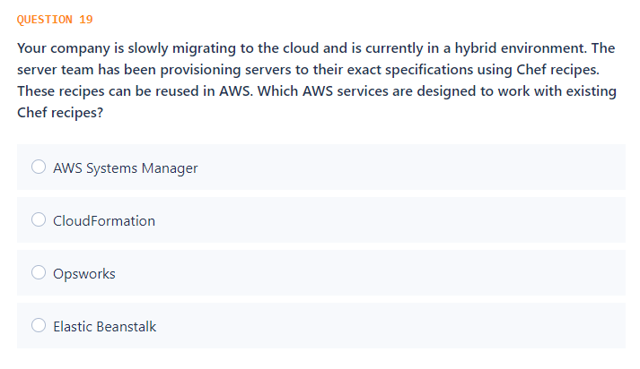

Slide 21
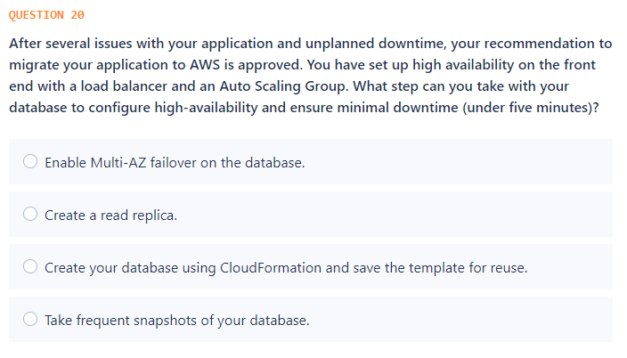

Slide 22
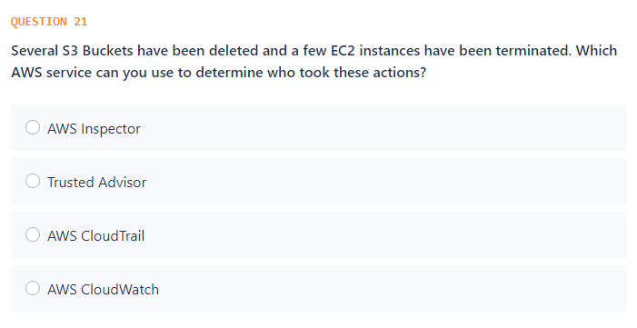

Slide 23
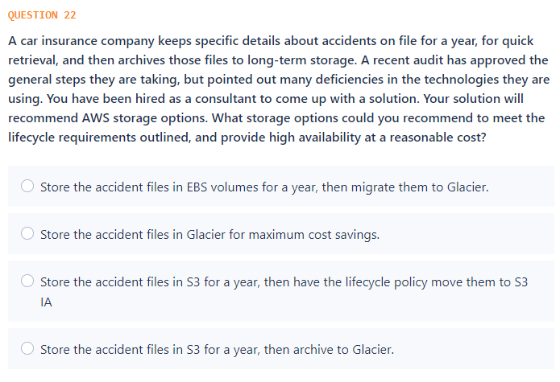

Slide 24
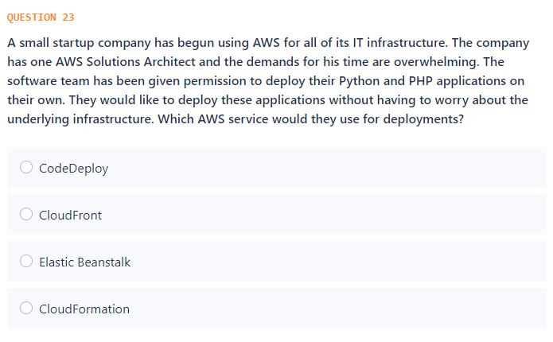

Slide 25
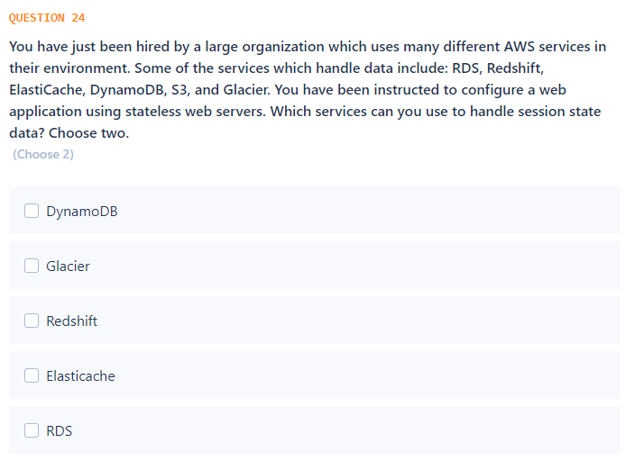

Slide 26
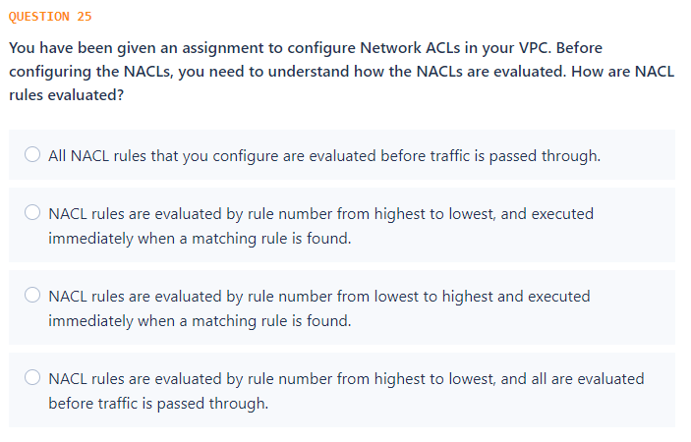

Slide 27
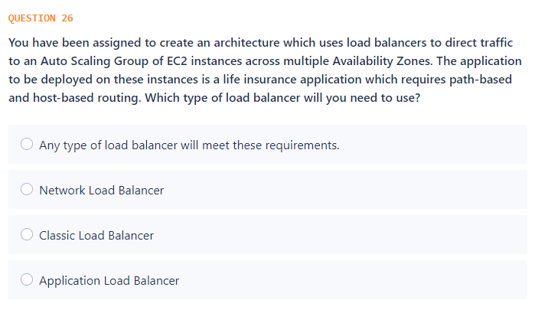

Slide 28
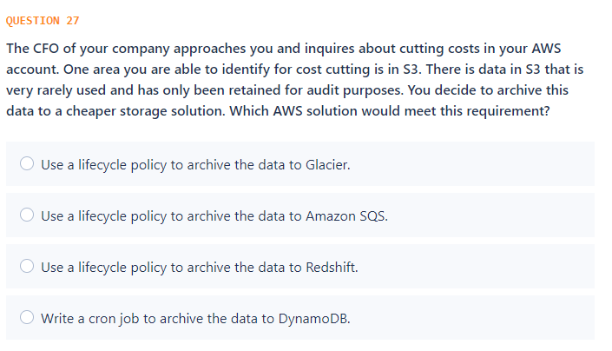

Slide 29
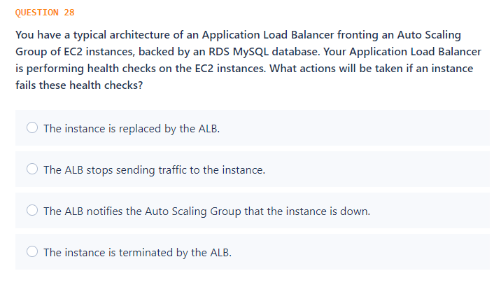

Slide 30
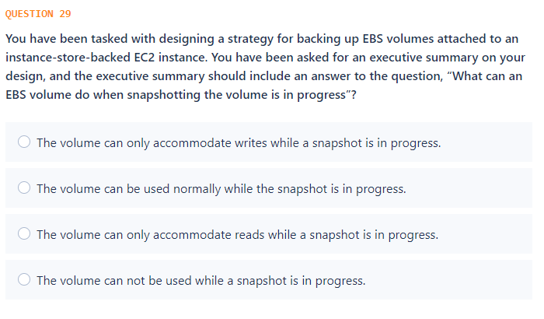

Slide 31
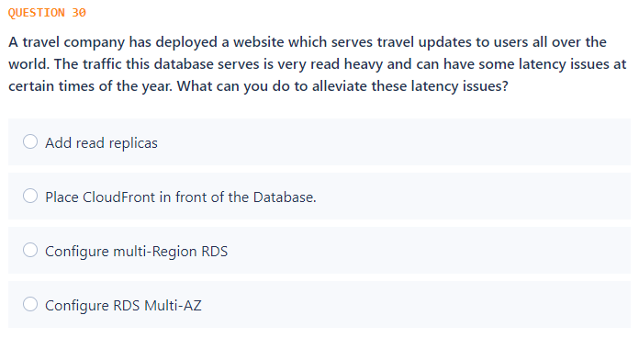

Slide 32
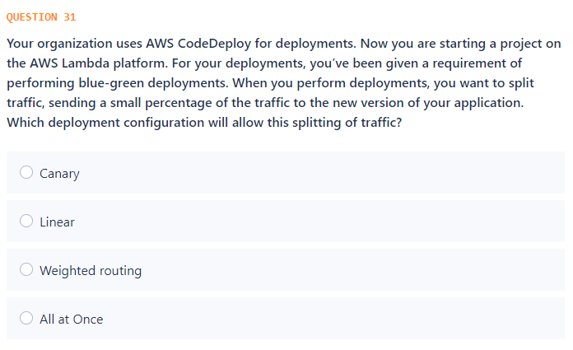

Slide 33
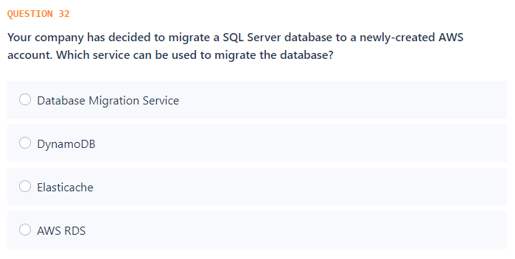

Slide 34
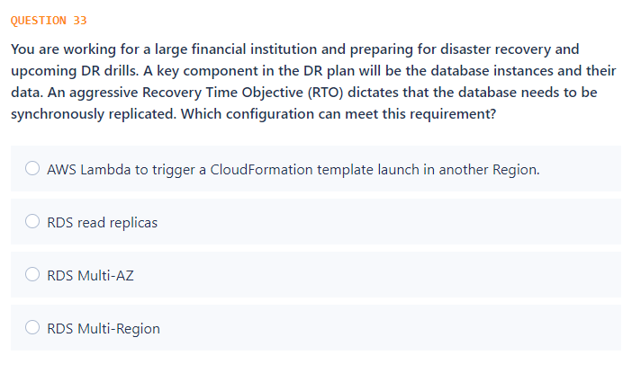

Slide 35
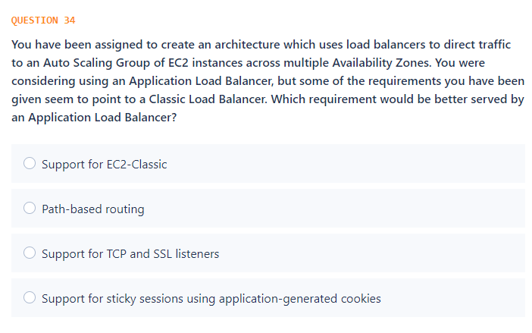

Slide 36
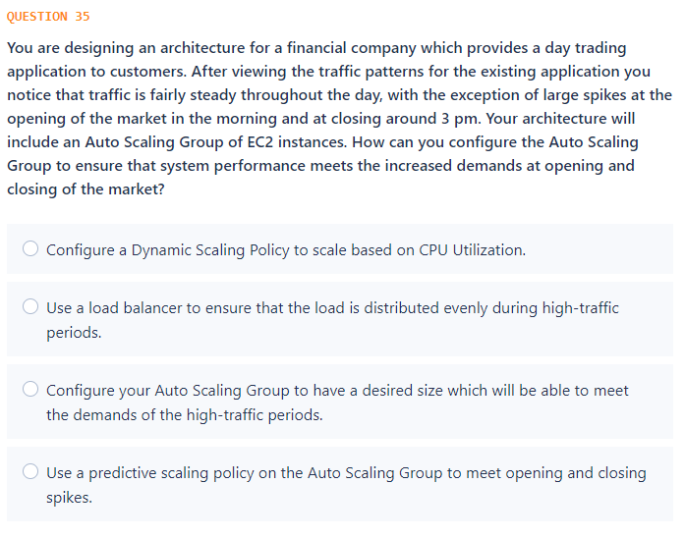

Slide 37
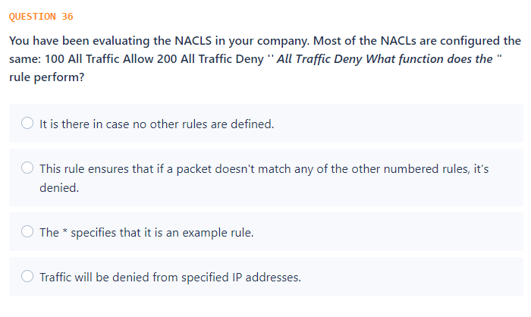

Slide 38
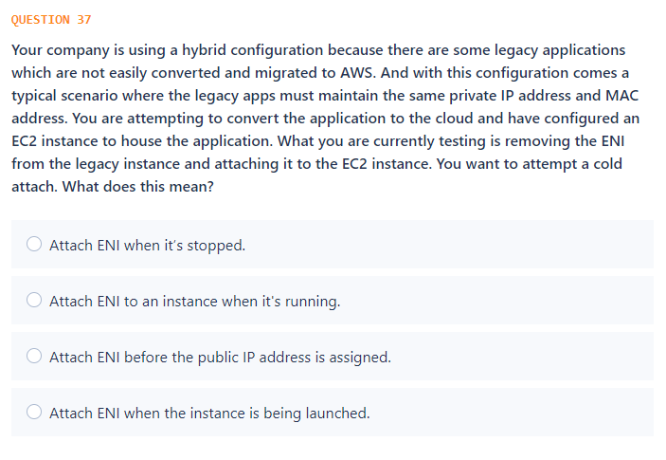

Slide 39
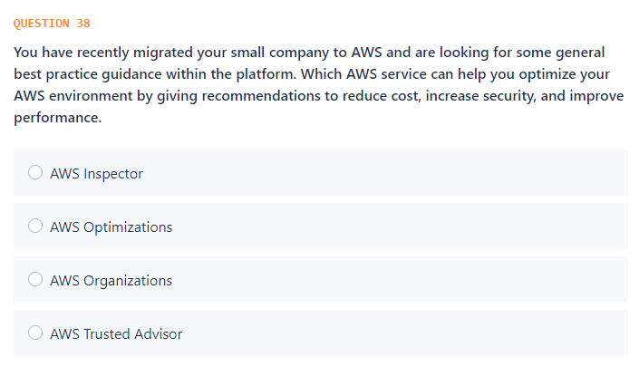

Slide 40
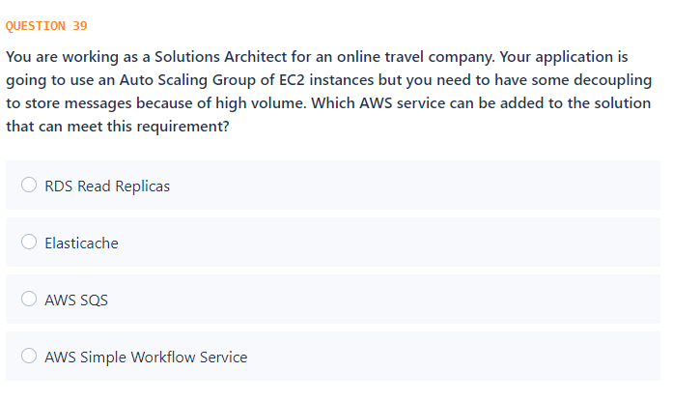

Slide 41
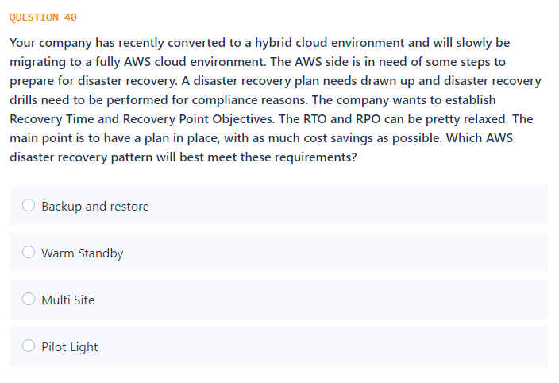

Slide 42
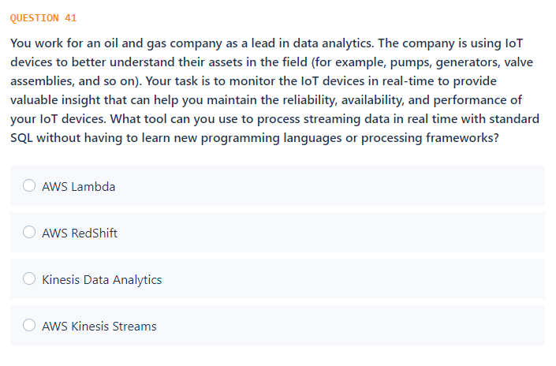

Slide 43
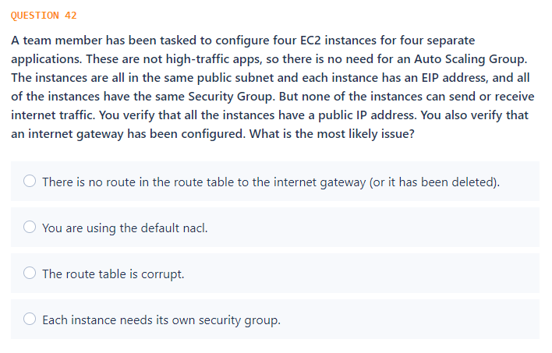

Slide 44
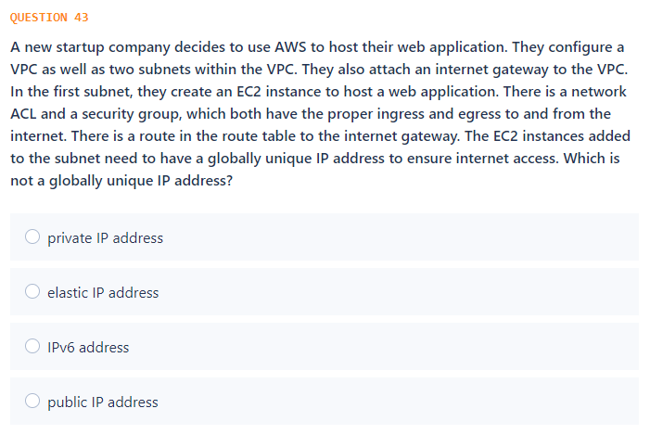

Slide 45
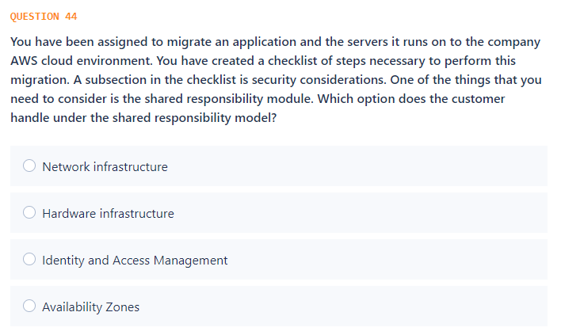

Slide 46
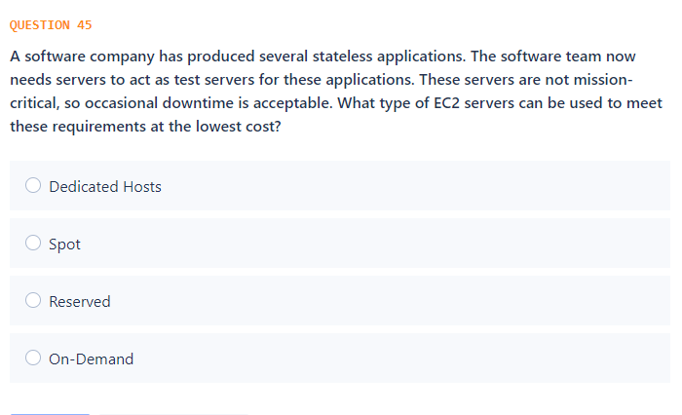

Slide 47
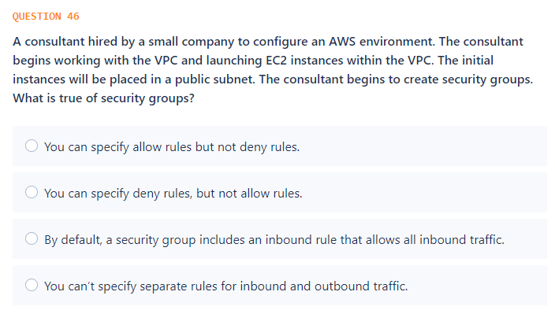

Slide 48
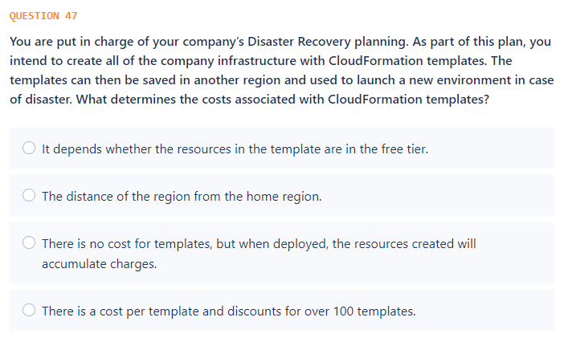

Slide 49
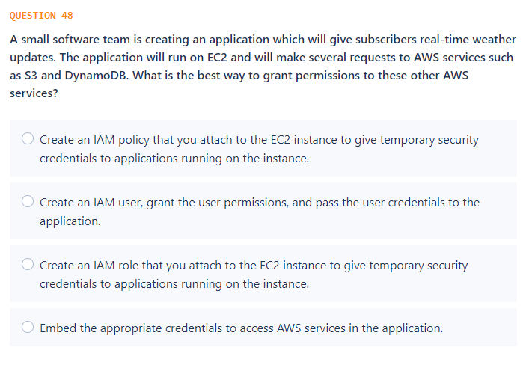

Slide 50
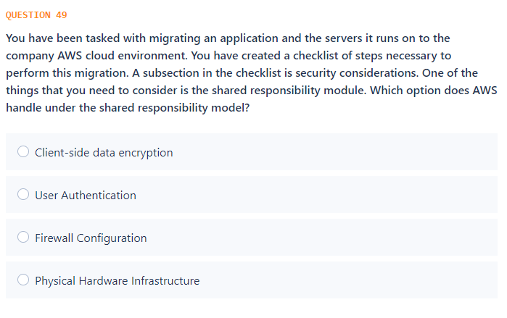

Slide 51
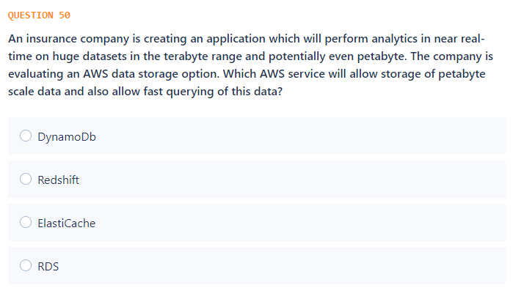

Slide 52


Slide 53


Slide 54


Slide 55


Slide 56


Slide 57


Slide 58


Slide 59


Slide 60


Slide 61


Slide 62


Slide 63


Slide 64


Slide 65


Slide 66


Slide 67
Answers

Slide 68

Notes:
https://docs.aws.amazon.com/whitepapers/latest/aws-vpc-connectivity-options/network-to-amazon-vpc-connectivity-options.html

Slide 69

Notes:
https://docs.aws.amazon.com/IAM/latest/UserGuide/id_credentials_temp.html

Slide 70

Notes:
https://aws.amazon.com/redshift/faqs/

Slide 71


Slide 72

Notes:
https://aws.amazon.com/solutions/case-studies/duolingo-case-study-dynamodb/

Slide 73


Slide 74

Notes:
https://docs.aws.amazon.com/AWSEC2/latest/UserGuide/EBSSnapshots.html

Slide 75


Slide 76

Notes:
References: https://aws.amazon.com/premiumsupport/knowledge-center/instance-store-vs-ebs/
https://docs.aws.amazon.com/AWSEC2/latest/UserGuide/InstanceStorage.html

Slide 77

Notes:
https://docs.aws.amazon.com/autoscaling/ec2/userguide/as-using-sqs-queue.html

Slide 78

Notes:
https://docs.aws.amazon.com/whitepapers/latest/aws-vpc-connectivity-options/aws-direct-connect.html

Slide 79

Notes:
https://docs.aws.amazon.com/amazondynamodb/latest/developerguide/AutoScaling.html

Slide 80

Notes:
https://aws.amazon.com/about-aws/whats-new/2018/01/amazon-rds-read-replicas-now-support-multi-az-deployments/#:~:text=Amazon%20RDS%20Read%20Replicas%20Now%20Support%20Multi%2DAZ%20Deployments,-Posted%20On%3A%20Jan&text=Amazon%20RDS%20Read%20Replicas%20enable,copied%20to%20your%20Read%20Replicas.

Slide 81

Notes:
https://docs.aws.amazon.com/vpc/latest/userguide/VPC_Subnets.html

Slide 82

Notes:
https://docs.aws.amazon.com/autoscaling/ec2/userguide/LaunchConfiguration.html

Slide 83


Slide 84


Notes:
https://docs.aws.amazon.com/vpc/latest/userguide/VPC_Internet_Gateway.html

Slide 85

Notes:
https://docs.aws.amazon.com/AmazonS3/latest/dev/object-lifecycle-mgmt.html

Slide 86

Notes:
https://docs.aws.amazon.com/opsworks/latest/userguide/workingcookbook-chef11.html

Slide 87

Notes:
https://docs.aws.amazon.com/AmazonRDS/latest/UserGuide/Concepts.MultiAZ.html

Slide 88


Slide 89


Slide 90

Notes:
https://docs.aws.amazon.com/elasticbeanstalk/latest/dg/Welcome.html

Slide 91

Notes:
https://aws.amazon.com/caching/session-management/
https://docs.aws.amazon.com/sdk-for-net/v2/developer-guide/dynamodb-session-net-sdk.html
https://aws.amazon.com/caching/session-management/
https://docs.aws.amazon.com/sdk-for-net/v2/developer-guide/dynamodb-session-net-sdk.html

Slide 92


Notes:
https://docs.aws.amazon.com/vpc/latest/userguide/vpc-network-acls.html#nacl-rules

Slide 93


Notes:
https://docs.aws.amazon.com/elasticloadbalancing/latest/application/introduction.html#application-load-balancer-benefits https://aws.amazon.com/elasticloadbalancing/faqs/

Slide 94

Notes:
https://docs.aws.amazon.com/AmazonS3/latest/dev/lifecycle-transition-general-considerations.html

Slide 95

Notes:
https://docs.aws.amazon.com/elasticloadbalancing/latest/classic/elb-healthchecks.html

Slide 96

Notes:
https://docs.aws.amazon.com/AWSEC2/latest/UserGuide/ebs-creating-snapshot.html

Slide 97

Notes:
https://aws.amazon.com/rds/features/read-replicas/

Slide 98

Notes:
https://docs.aws.amazon.com/codedeploy/latest/userguide/welcome.html#blue-green-lambda-compute-type

Slide 99

Notes:
https://aws.amazon.com/dms/

Slide 100

Notes:
https://aws.amazon.com/rds/features/multi-az/

Slide 101


Notes:
https://docs.aws.amazon.com/elasticloadbalancing/latest/application/introduction.html

Slide 102



Slide 103

Notes:
https://docs.aws.amazon.com/vpc/latest/userguide/vpc-network-acls.html

Slide 104



Slide 105


Slide 106

Notes:
https://aws.amazon.com/sqs/

Slide 107


Slide 108

Notes:
https://docs.aws.amazon.com/solutions/latest/real-time-iot-device-monitoring-with-kinesis/overview.html

Slide 109

Notes:
https://docs.aws.amazon.com/AmazonECS/latest/developerguide/create-public-private-vpc.html

Slide 110


Slide 111

Notes:
https://aws.amazon.com/compliance/shared-responsibility-model/

Slide 112

Notes:
https://docs.aws.amazon.com/whitepapers/latest/cost-optimization-leveraging-ec2-spot-instances/when-to-use-spot-instances.html

Slide 113

Notes:
https://docs.aws.amazon.com/vpc/latest/userguide/VPC_SecurityGroups.html

Slide 114

Notes:
https://aws.amazon.com/cloudformation/pricing/

Slide 115

Notes:
https://docs.aws.amazon.com/IAM/latest/UserGuide/id.html#id_which-to-choose_role

Slide 116

Notes:
https://aws.amazon.com/compliance/shared-responsibility-model/

Slide 117

Notes:
https://docs.aws.amazon.com/redshift/latest/mgmt/welcome.html
https://docs.aws.amazon.com/redshift/latest/gsg/getting-started.html

Slide 118

Notes:
https://aws.amazon.com/athena/?whats-new-cards.sort-by=item.additionalFields.postDateTime&whats-new-cards.sort-order=desc

Slide 119

Notes:
https://docs.aws.amazon.com/vpc/latest/userguide/VPC_SecurityGroups.html

Slide 120

Notes:
https://aws.amazon.com/elasticache/redis-vs-memcached/

Slide 121

Notes:
https://docs.aws.amazon.com/vpc/latest/userguide/VPC_SecurityGroups.html

Slide 122

Notes:
https://docs.aws.amazon.com/AmazonS3/latest/dev/mpuoverview.html

Slide 123


Slide 124

Notes:
https://docs.aws.amazon.com/AmazonVPC/latest/UserGuide/VPC_Scenario2.html

Slide 125

Notes:
https://docs.aws.amazon.com/autoscaling/ec2/userguide/Cooldown.html

Slide 126

Notes:
https://docs.aws.amazon.com/vpc/latest/userguide/vpn-connections.html

Slide 127

Notes:
https://docs.aws.amazon.com/AmazonRDS/latest/UserGuide/Concepts.MultiAZ.html

Slide 128

Notes:
https://docs.aws.amazon.com/IAM/latest/UserGuide/id_groups.html

Slide 129

Notes:
https://aws.amazon.com/premiumsupport/knowledge-center/geolocation-routing-policy/

Slide 130

Notes:
https://docs.aws.amazon.com/vpc/latest/userguide/VPC_SecurityGroups.html

Slide 131

Notes:
https://docs.aws.amazon.com/vpc/latest/userguide/VPC_Internet_Gateway.html

Slide 132

Notes:
https://docs.aws.amazon.com/AmazonCloudWatch/latest/monitoring/UsingAlarmActions.html

